Slide 1
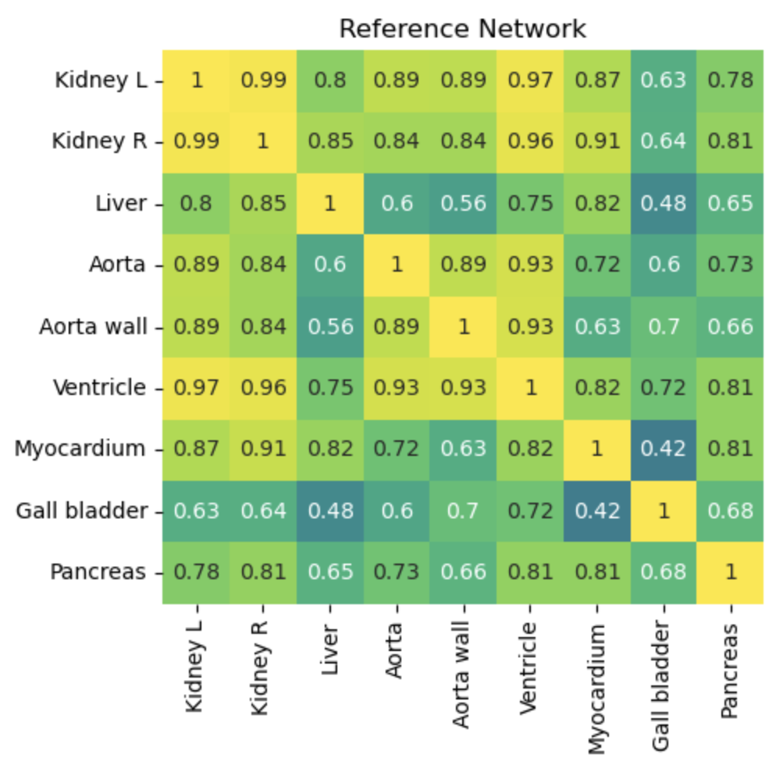
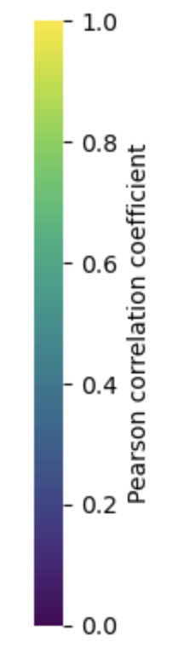
The data
n=13 control subjects (PCC reference network for the controls to the right)
n=9 post-rifampicin-infusion subjects (repeats from control subjects)
Mix of male/female and ages

Slide 2
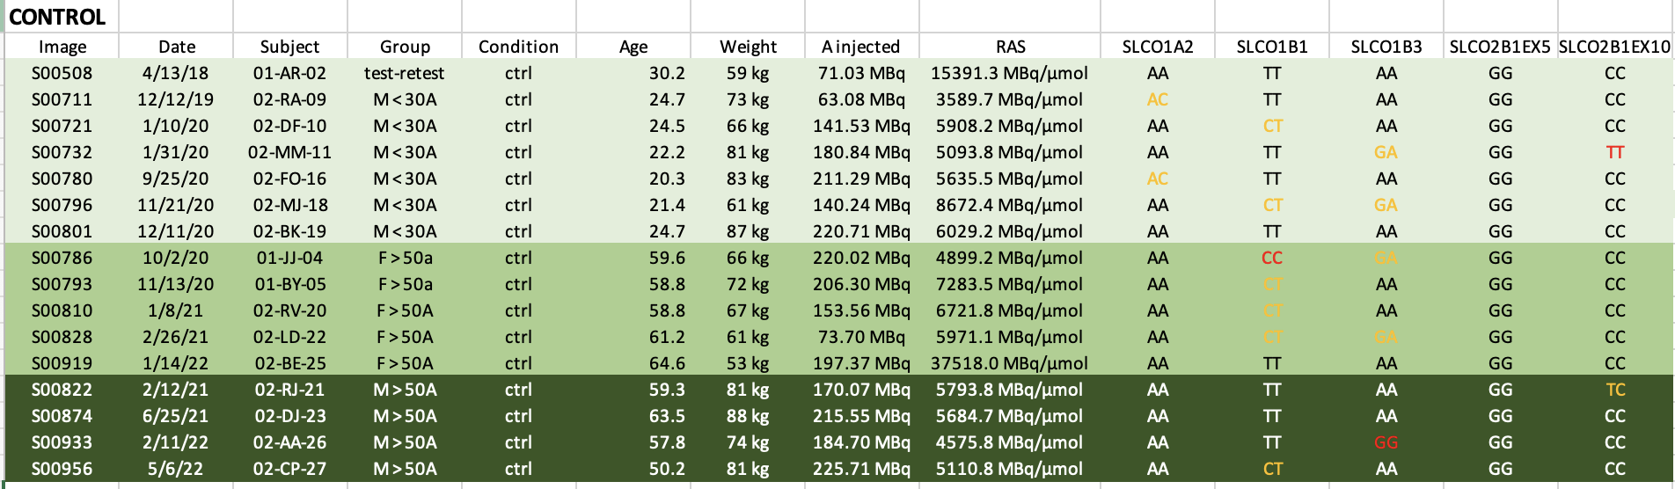
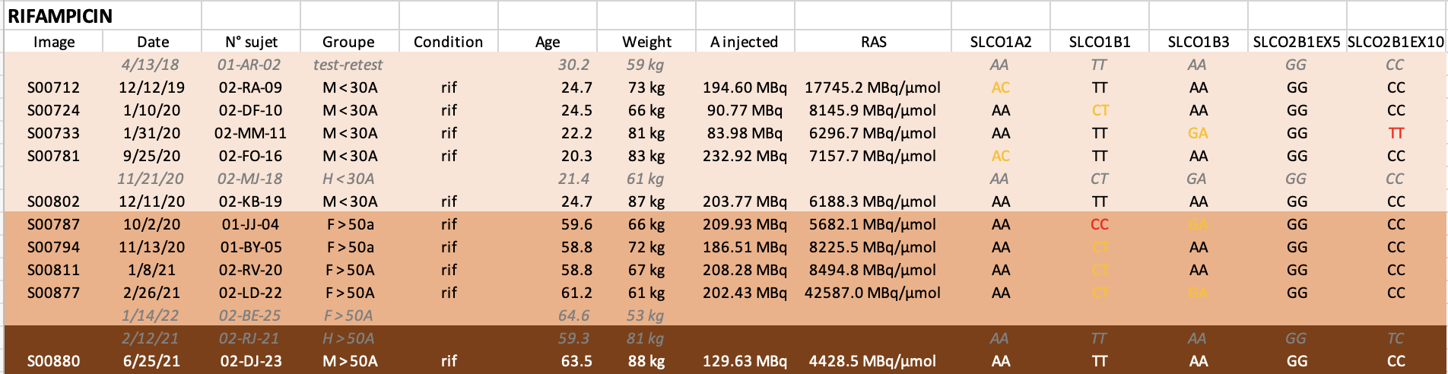
The patients
I’ve added the matches on the left – as previously discussed, many of the controls (six) aren’t in the rifampicin cohort for various reasons, but I’m realizing now I’ve left out two of the controls that were re-scanned, so I need to go back to my notes and figure out why I left those ones out (likely something odd with the data, i.e. the too-short scan or similar). But it could be that I need to re-add them, I’ll report back on that.

Slide 3
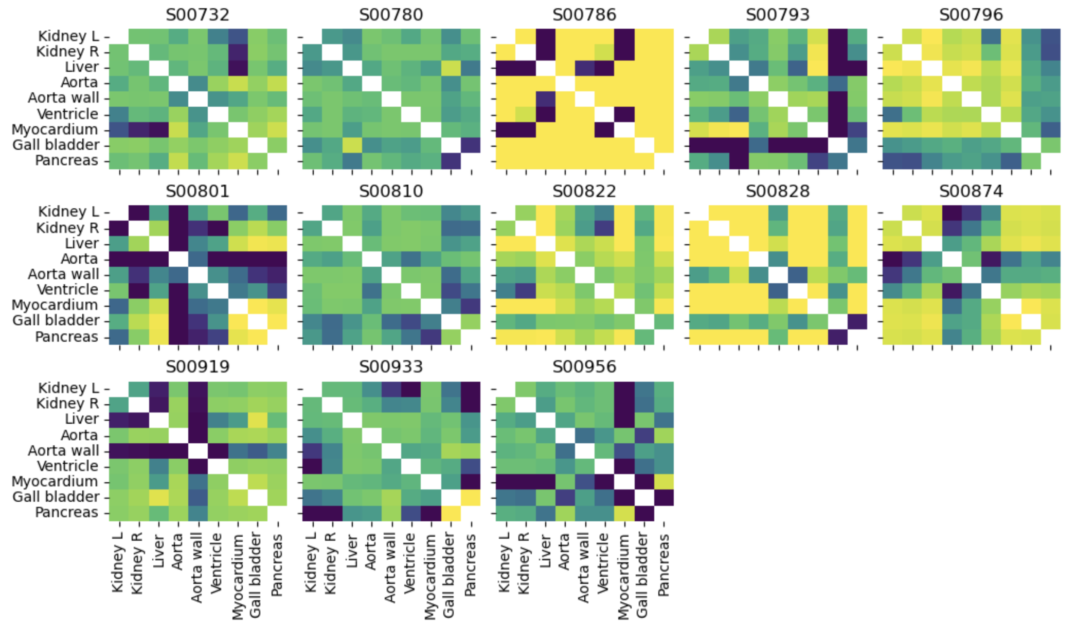
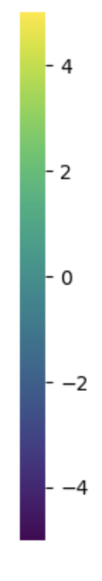
Z-scores, leave one out method, control group, range = [-5,5]

Slide 4
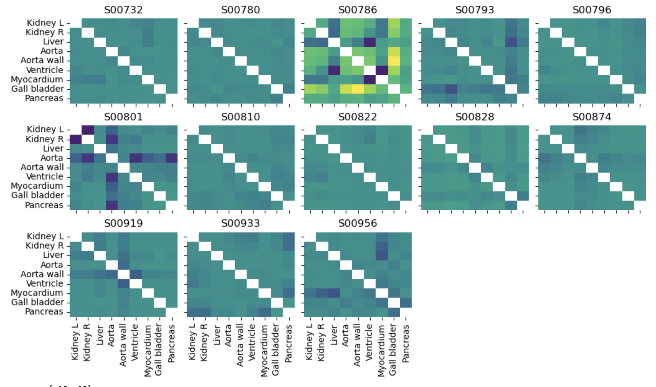
Z-scores, leave one out method, control group, range = [-10,10]

Slide 5
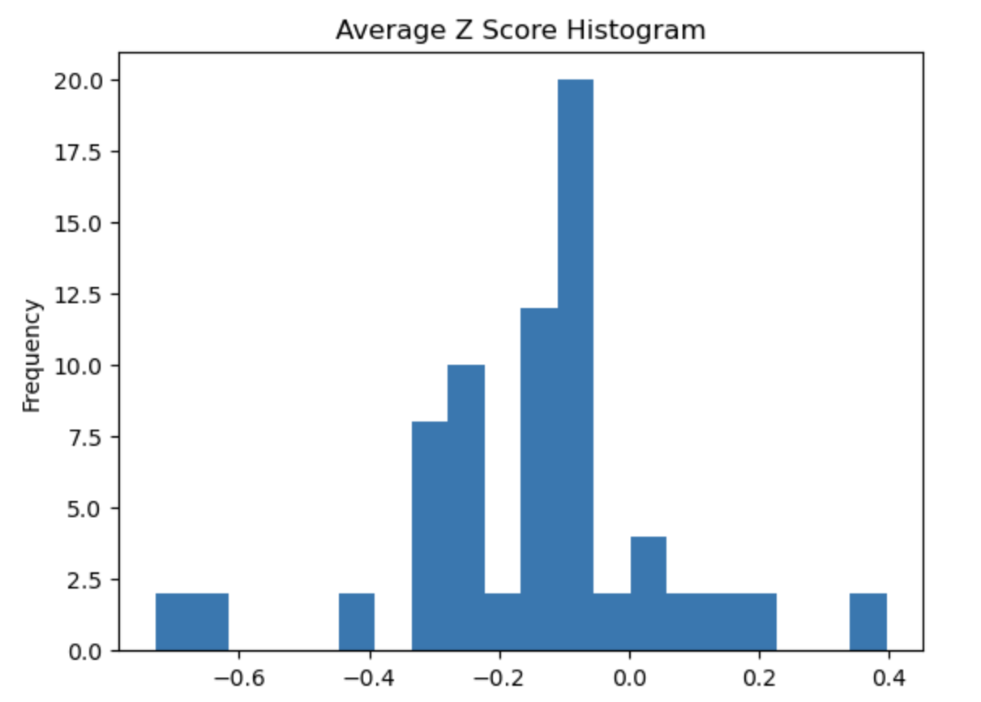
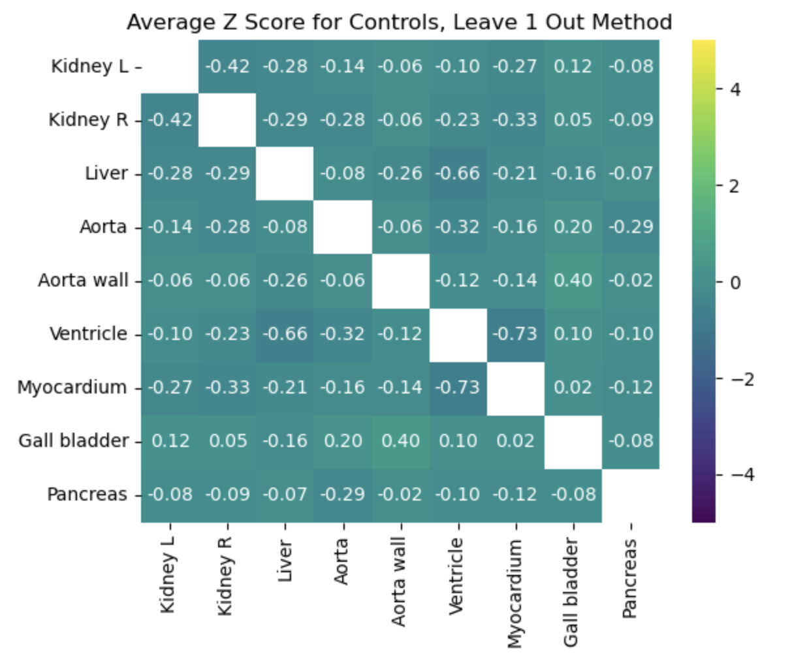
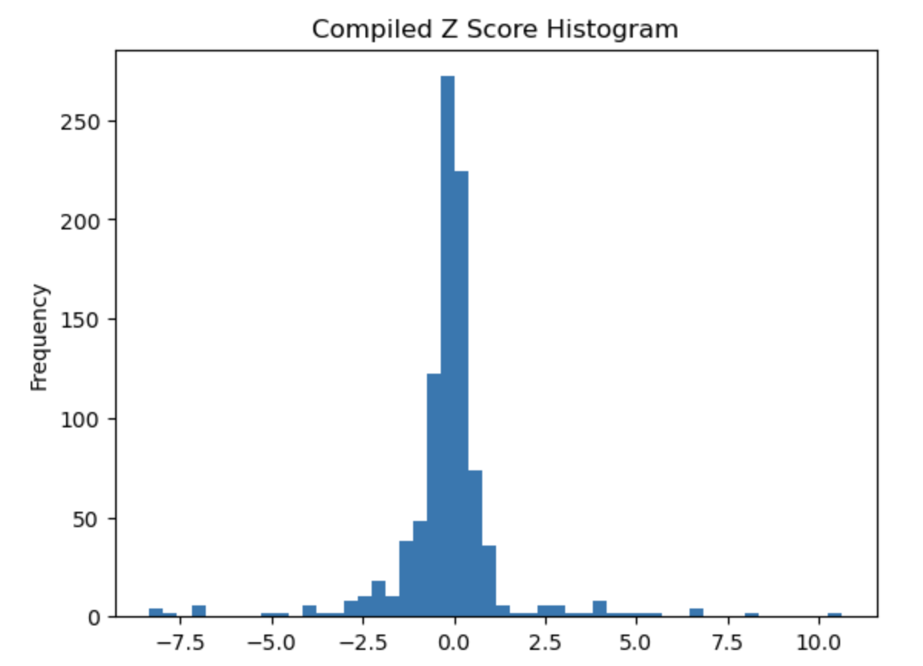
Average Z-scores, leave one out method, control group, range = [-5,5], histograms of the average values and all values

Slide 6
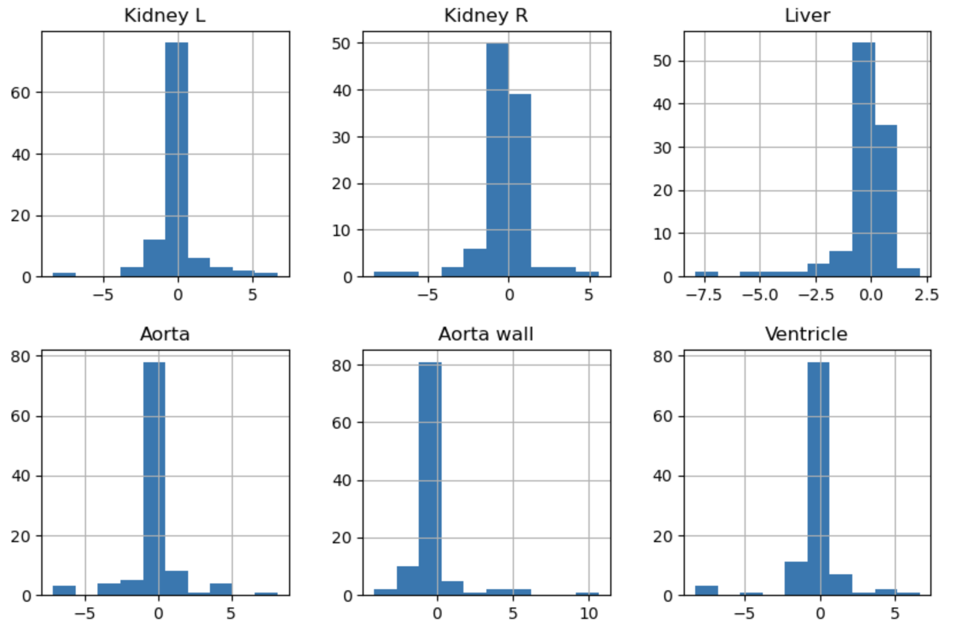
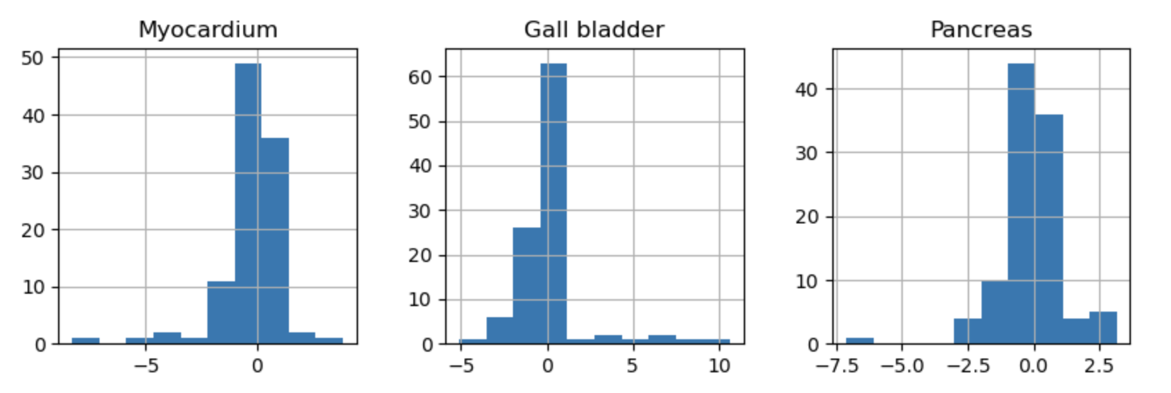
Histograms of all z-score values for leave one out method with controls for each individual region

Slide 7
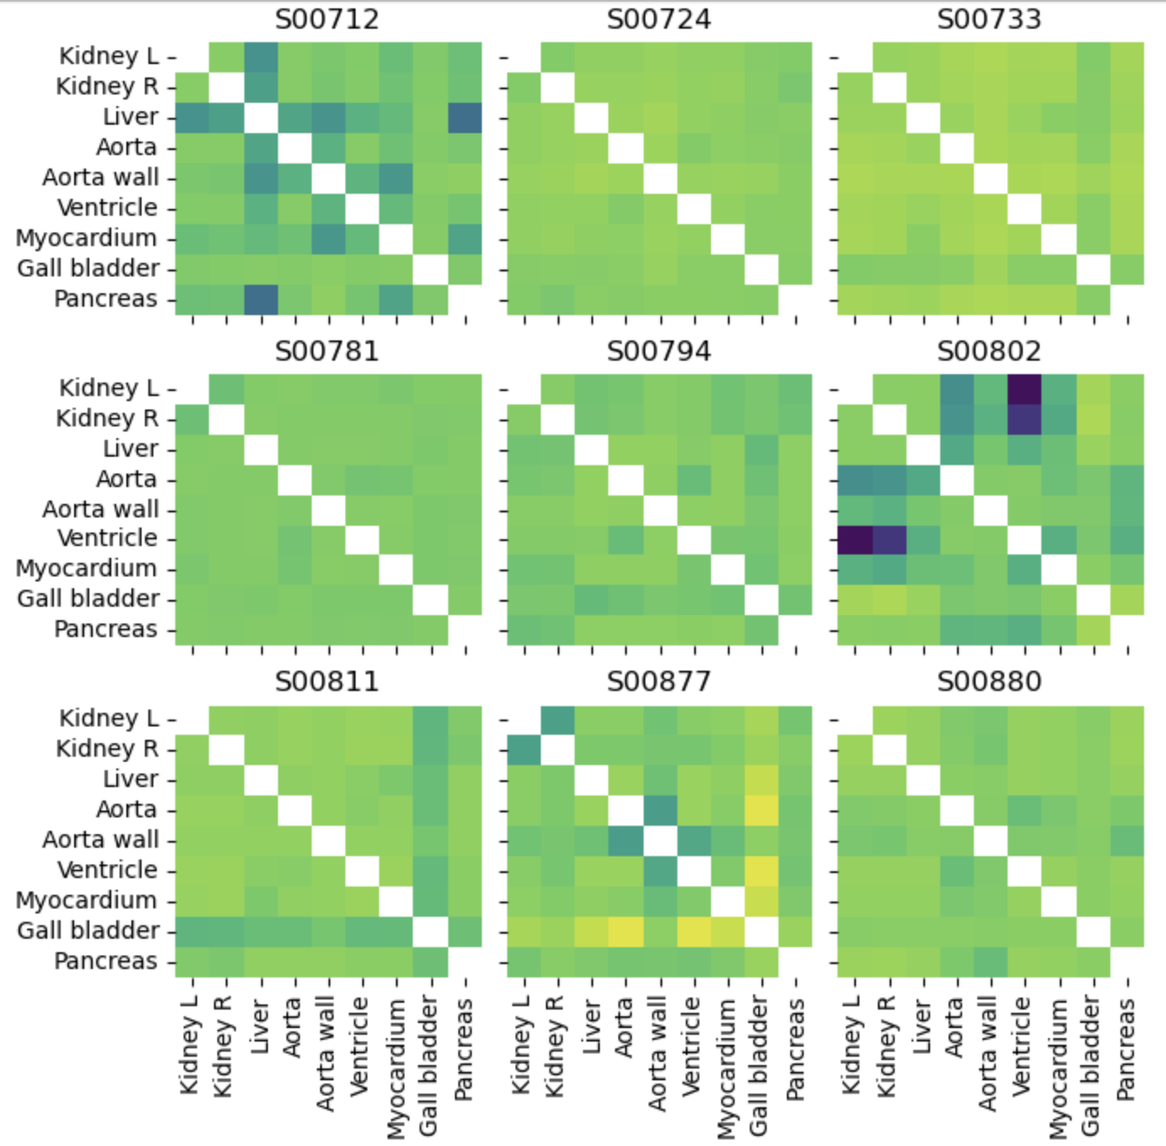
Z-scores, leave one out method, rifampicin group, range = [-14,4]

Slide 8
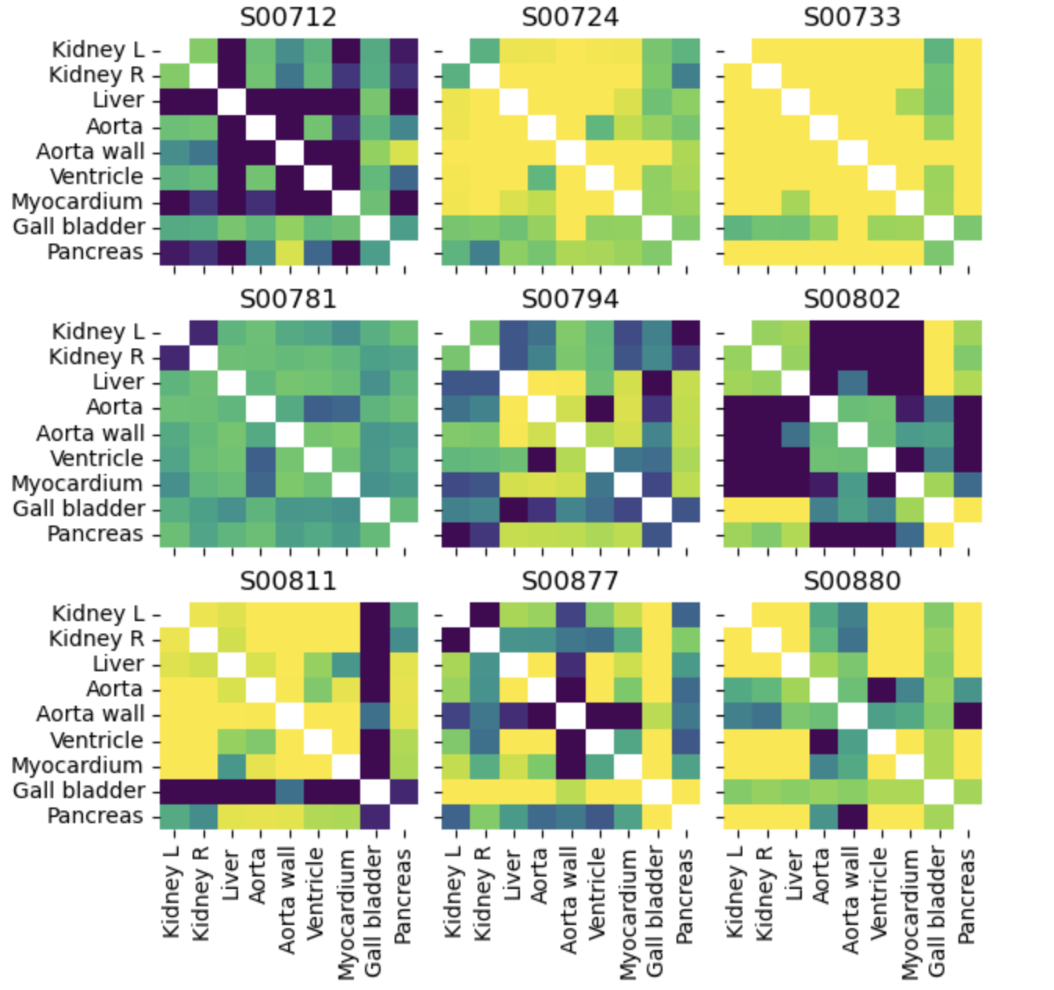
Z-scores, leave one out method, rifampicin group, range = [-1.25,0.5]

Slide 9
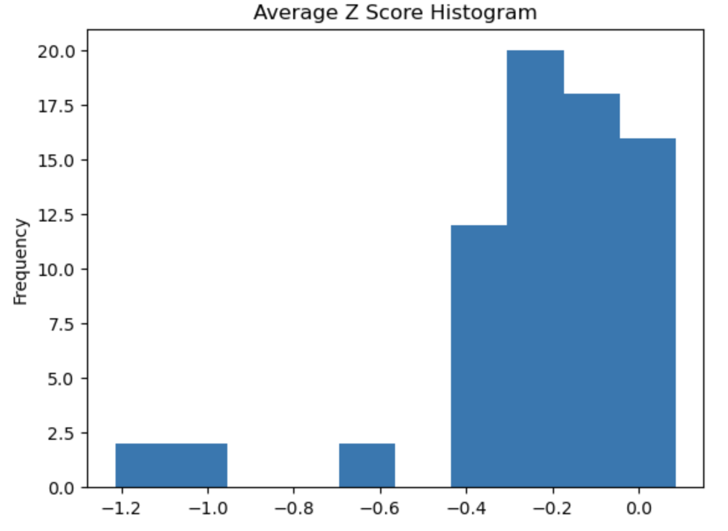
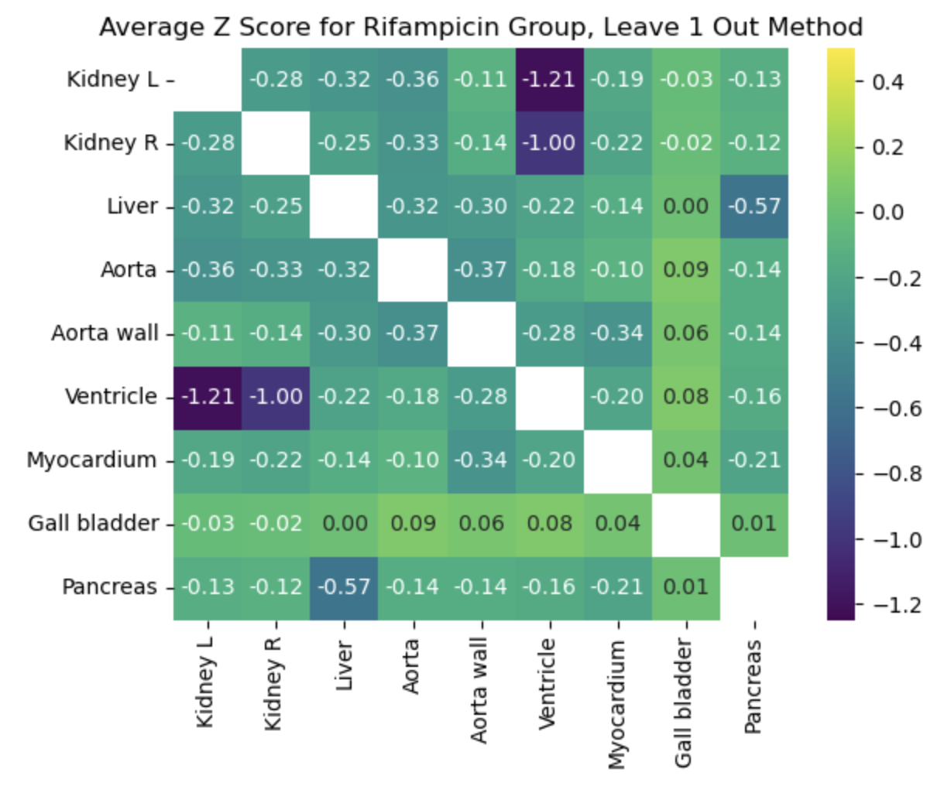
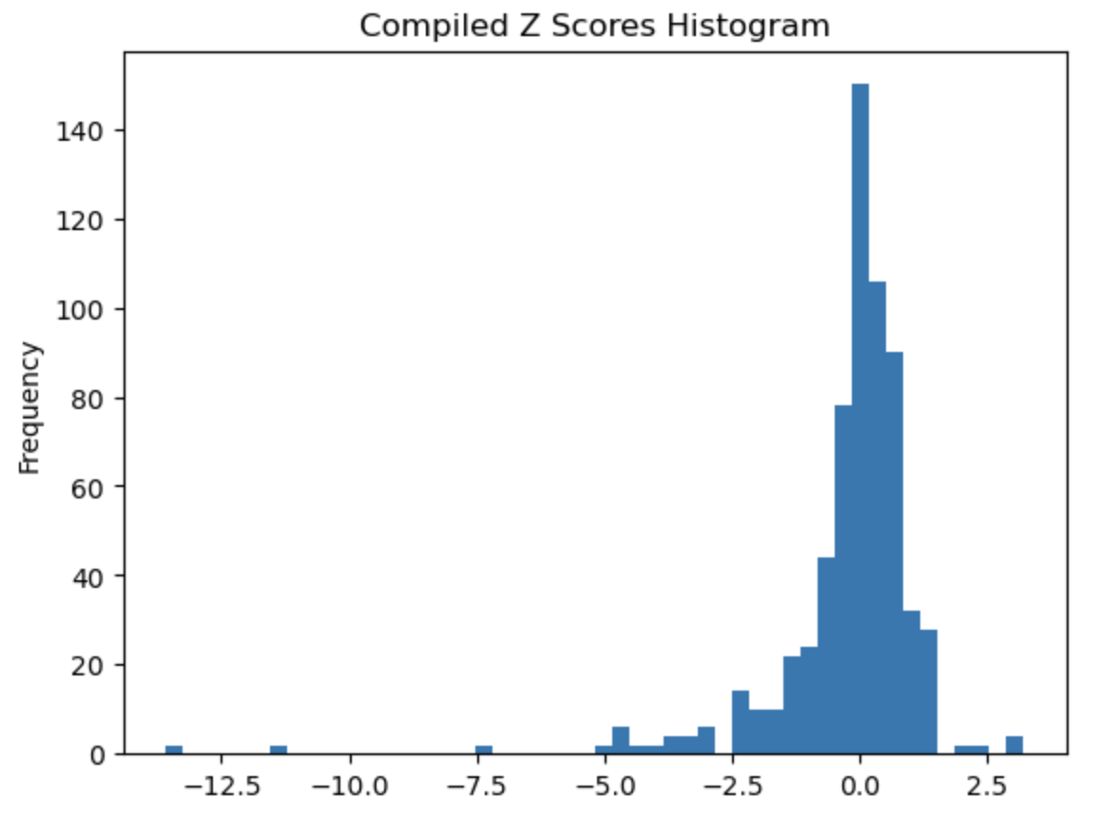
Average Z-scores, leave one out method, rifampicin group, range = [-1.25,0.5], histograms of the average values and all values

Slide 10
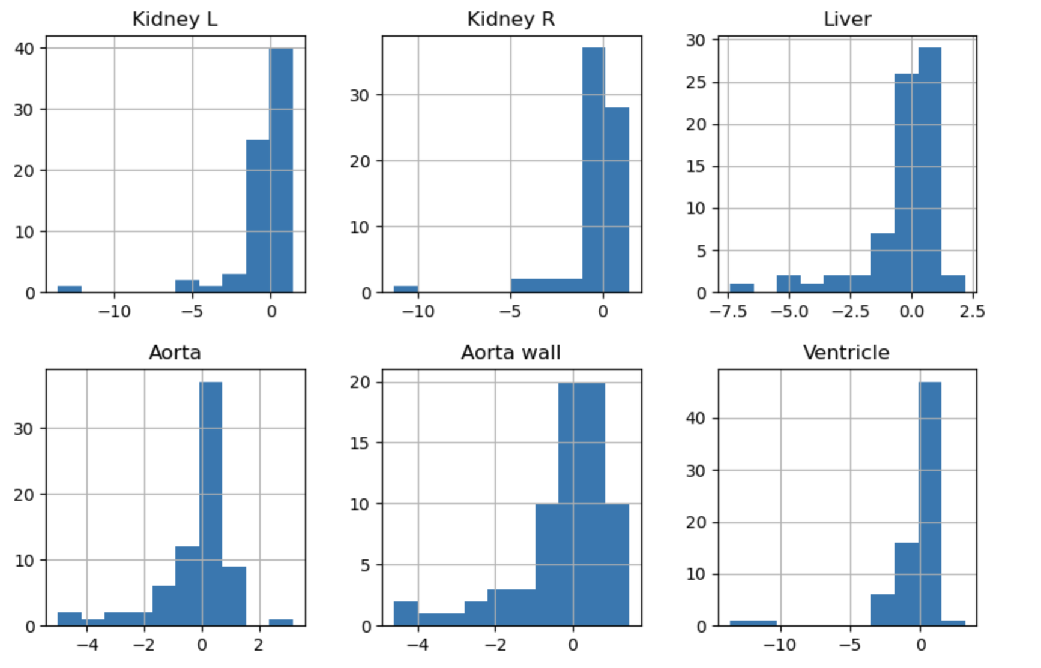
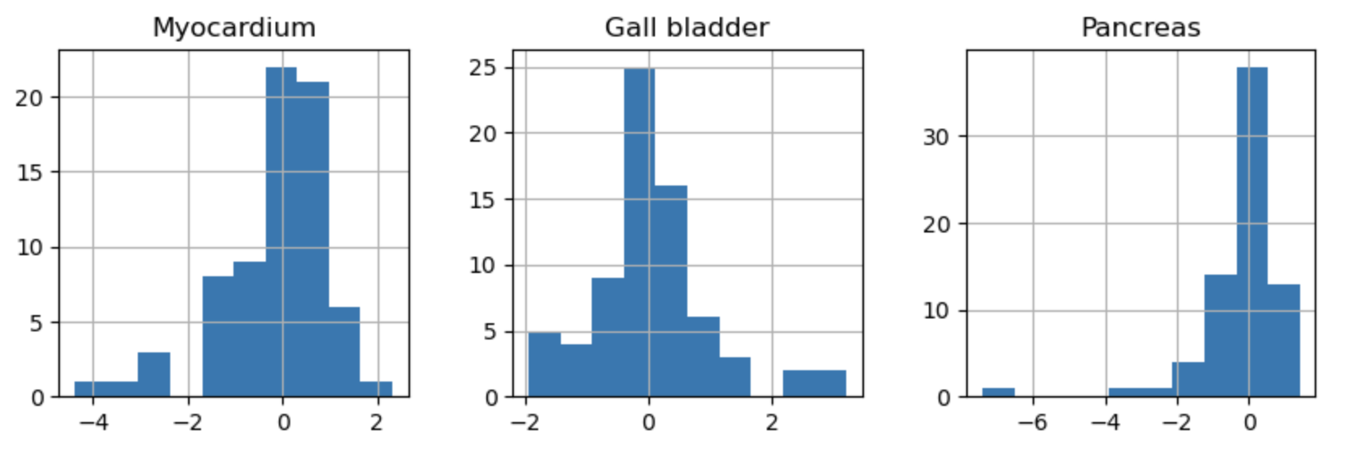
Histograms of all z-score values for leave one out method with rifampicin subjects for each individual region

Slide 11
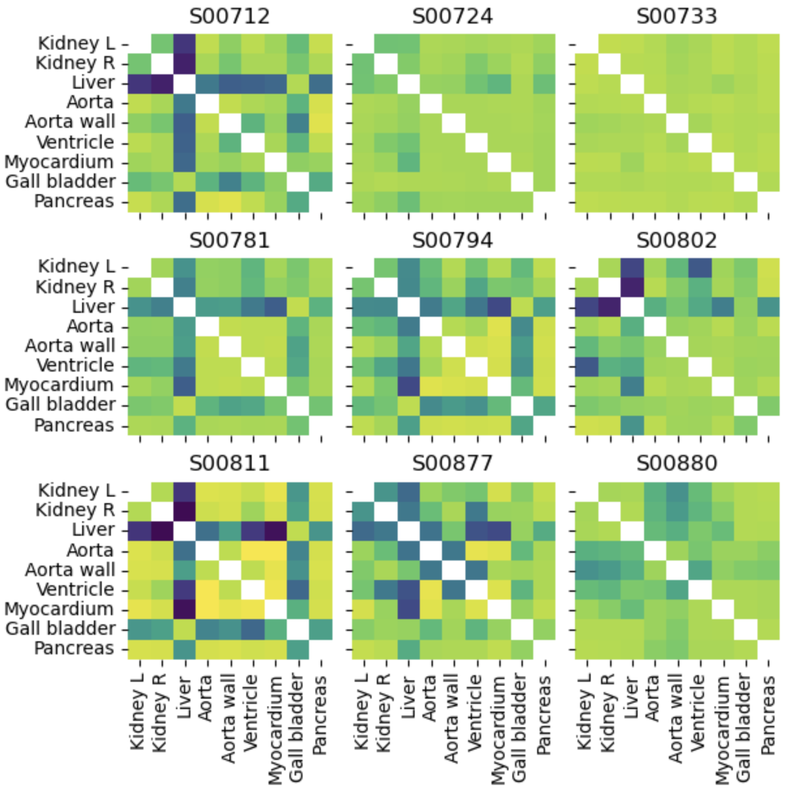
Z-scores for each rifampicin subject compared to the control group, range = [-11,2]

Slide 12
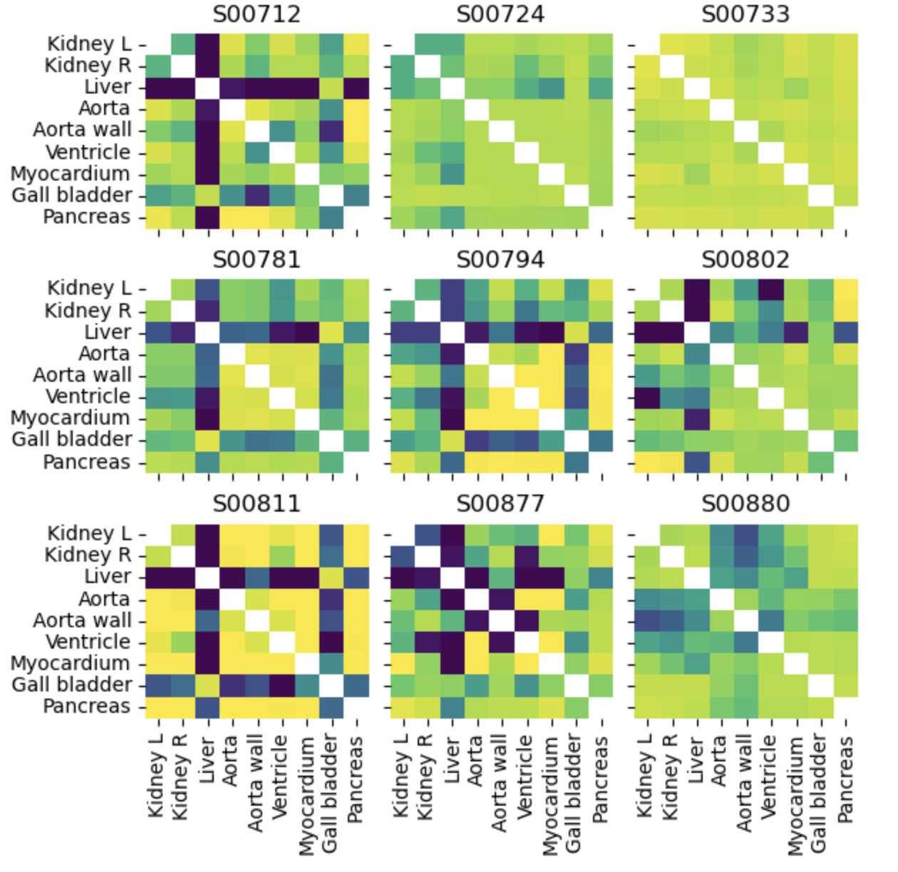
Z-scores for each rifampicin subject compared to the control group, range = [-6,1]

Slide 13
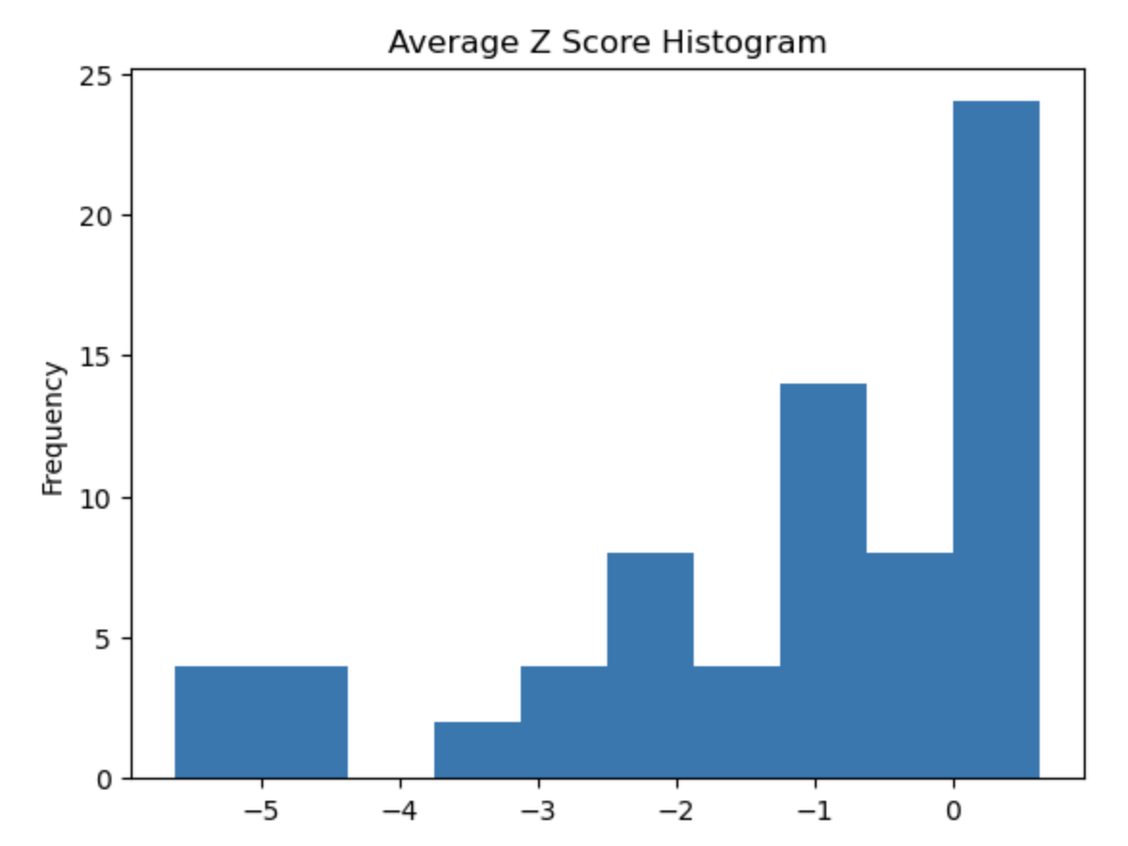
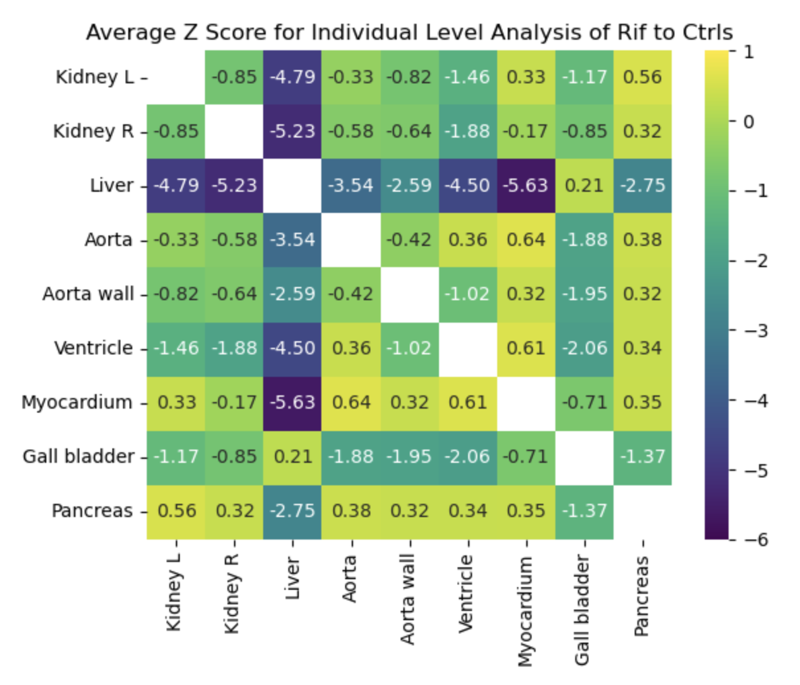
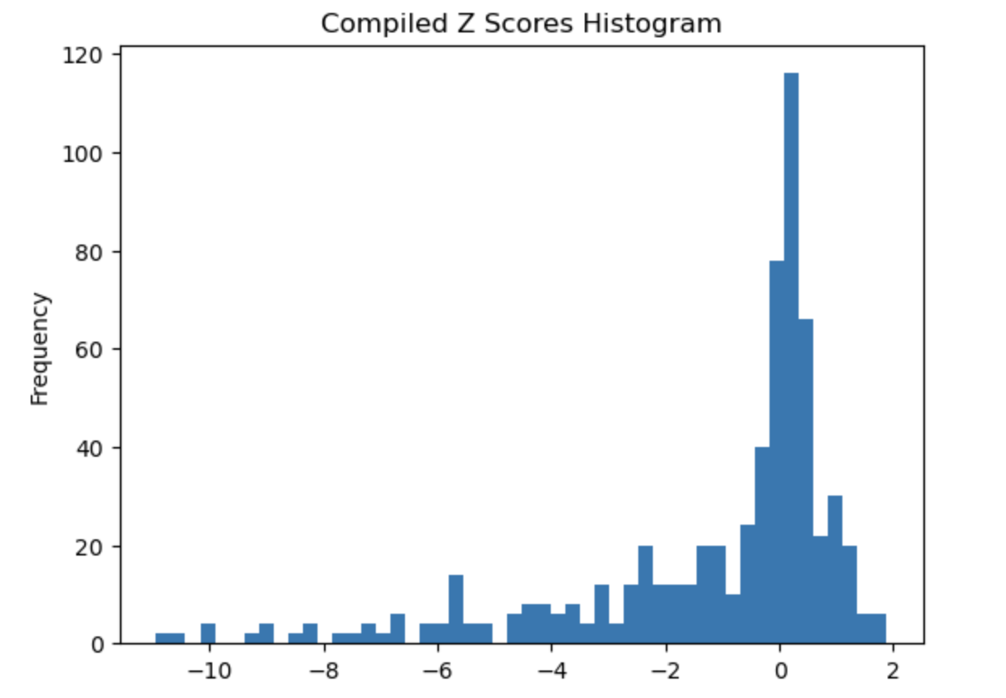
Average Z-scores, rifampicin group compared to controls, range = [-1.25,0.5], with histograms of the average values and all values

Slide 14
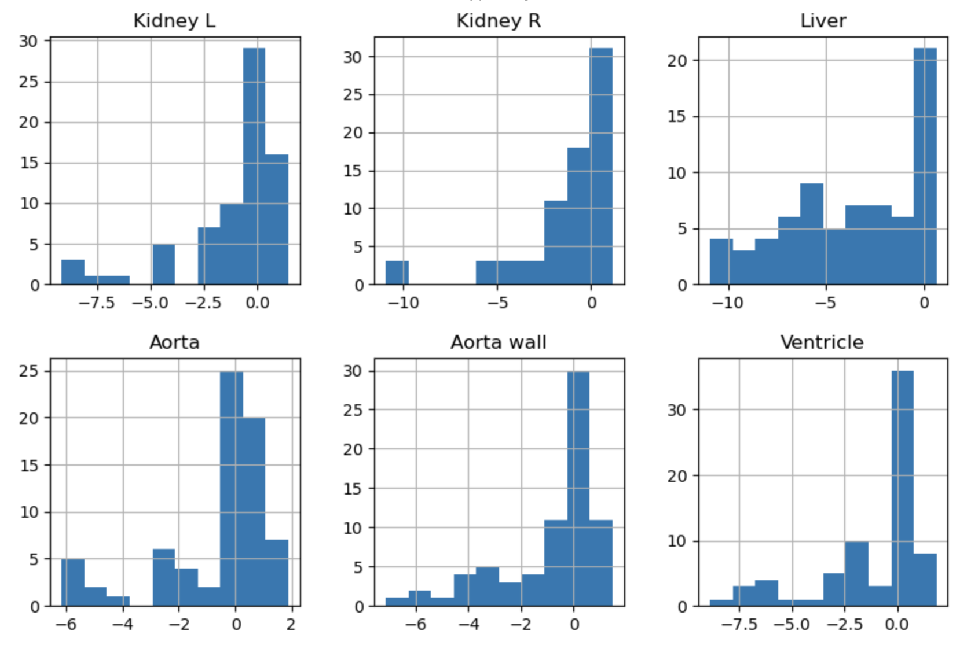
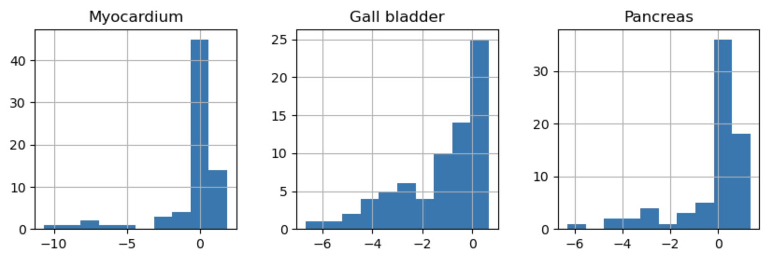
Histograms of all z-score values for rifampicin comparison to controls for each individual region

Slide 15
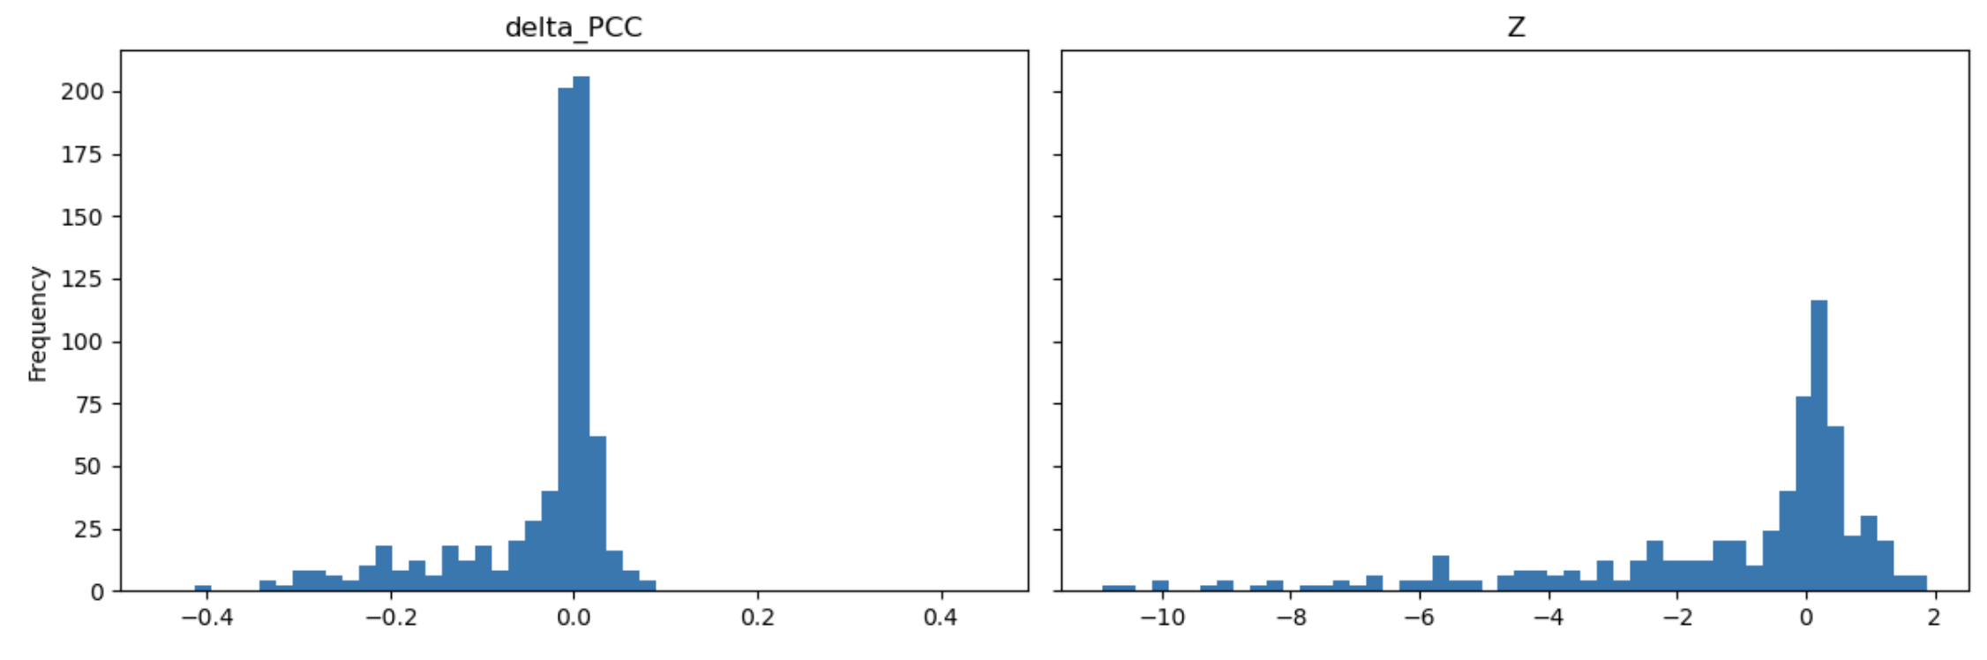
ΔPCC and Z score histograms for rifampicin group compared to controls (all values)

